Slide 1
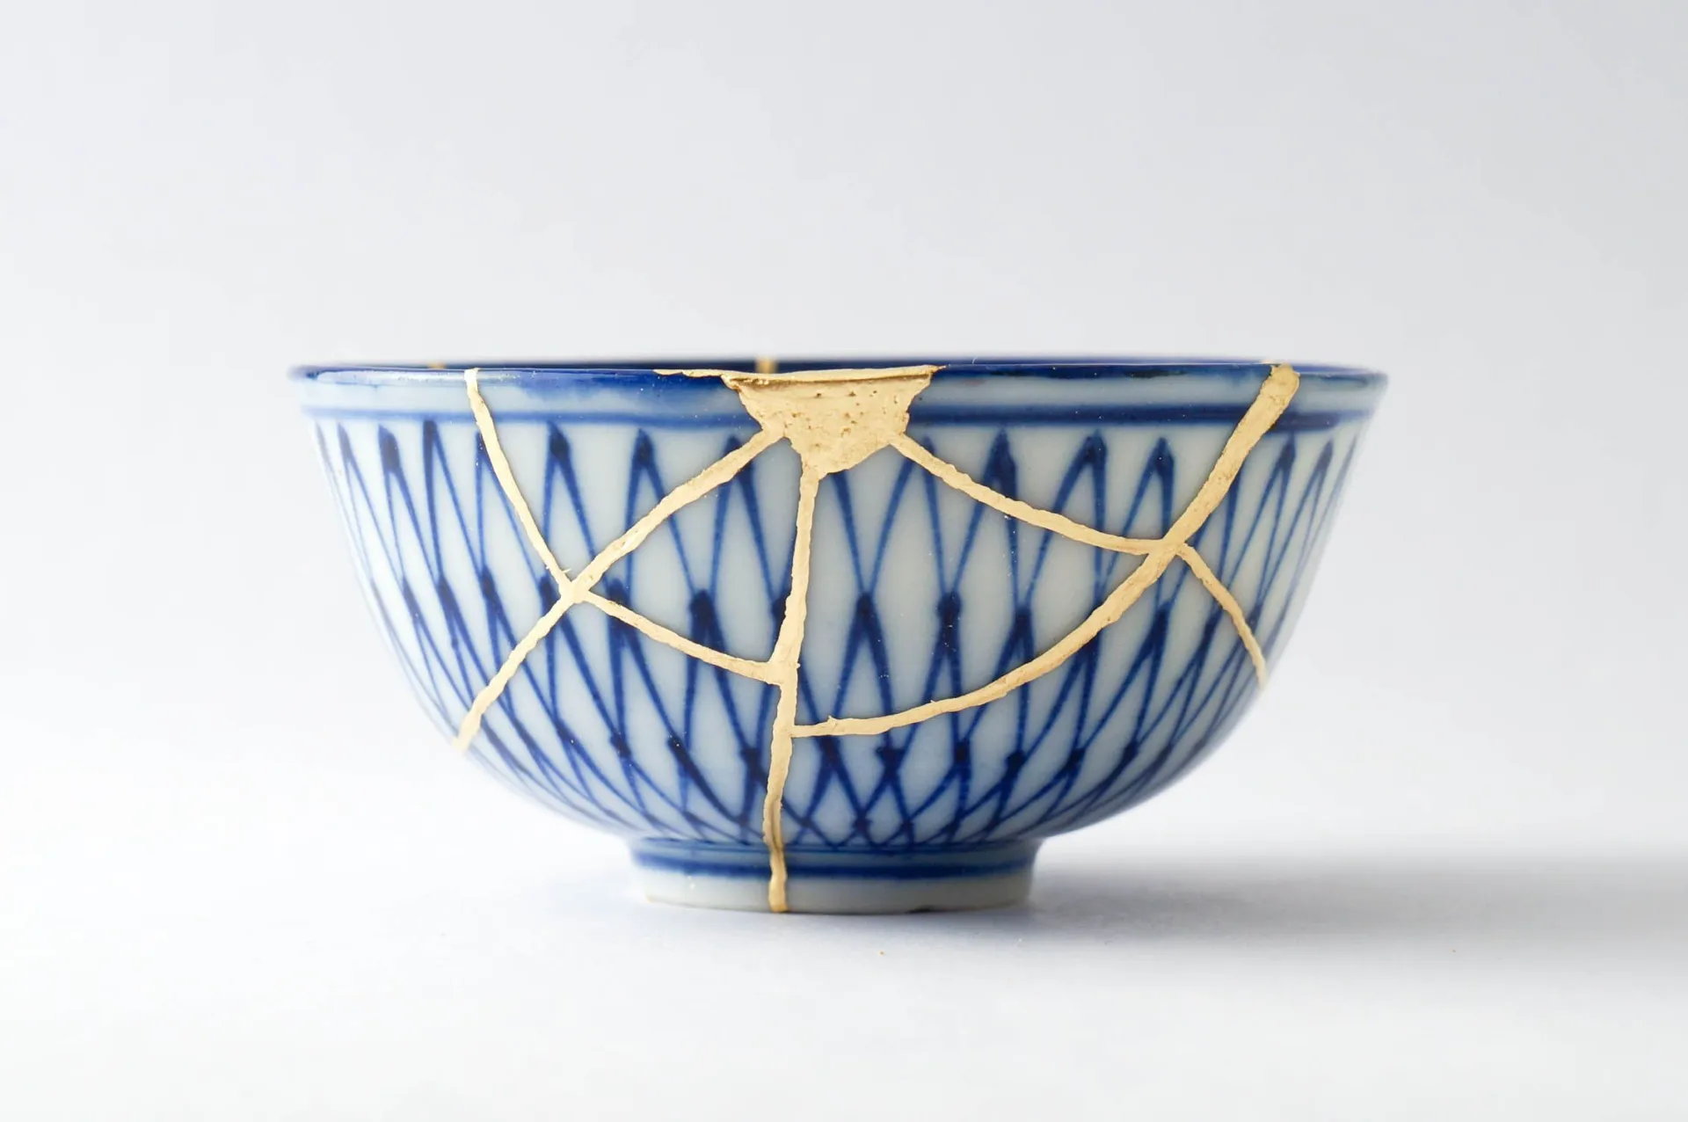
Cultural Impact

Slide 2
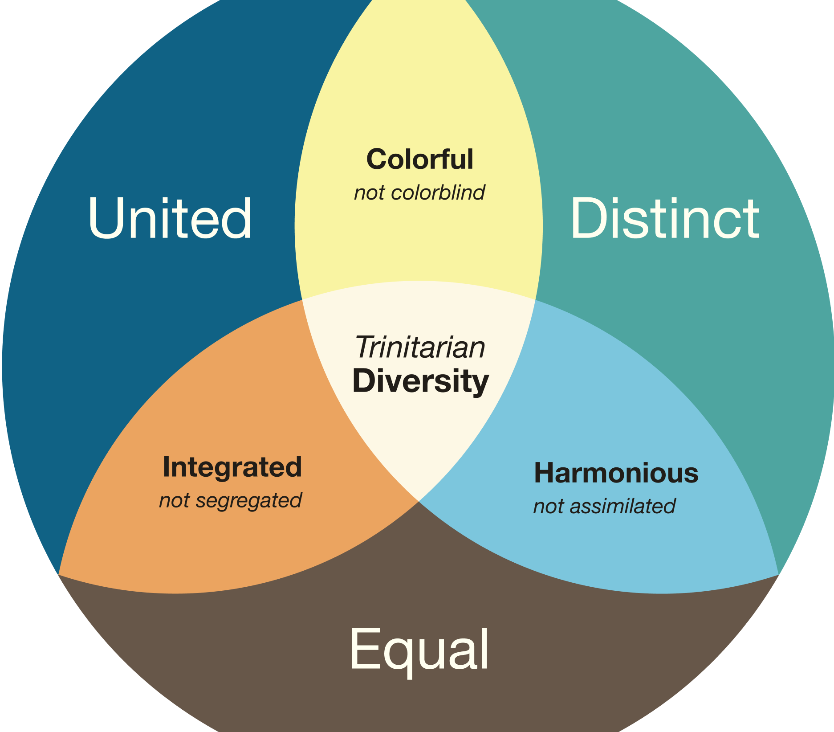
Goals
Develop awareness of our own culture and its impact on us
Learn to appreciate & evaluate different perspectives.
Notes:
This is Icon’s model of Trinitarian Diversity which we will be using as a basis of our cultural dynamics (briefly explain image)
->The goal of this presentation, and we will be going over this again, are:
->To Develop an awareness of our own culture, and its impact on us
->And To Learn to appreciate & evaluate different perspectives that are different from our own.

Slide 3
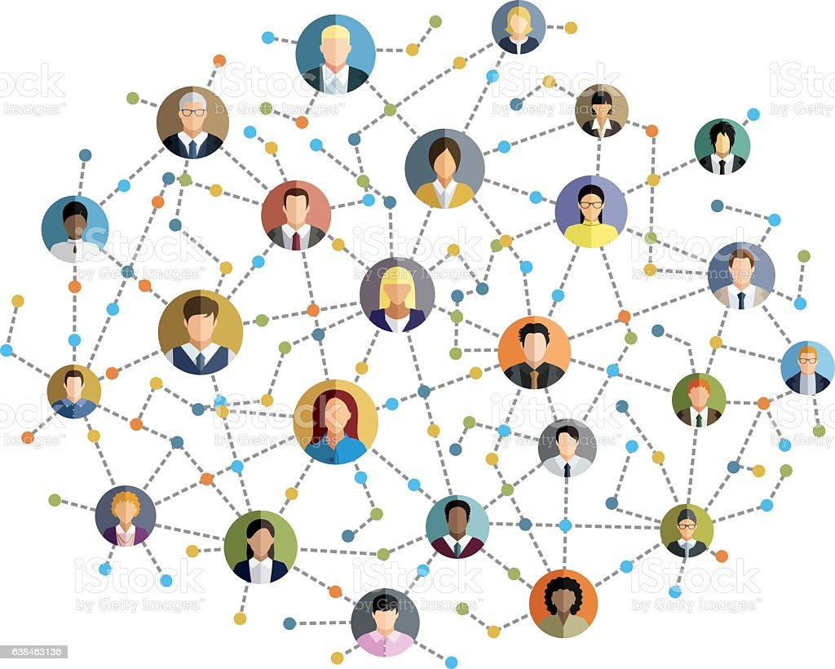
What is Culture?
Shared:
Practices
Values
Perceptions
Notes:
So let's start with a little bit of definition, what is culture? And I want you guys to be thinking about this too. What is culture?
->Now for our purposes, I’ll be simplifying it ->
->Culture is shared between many different people, where it is taught and reaffirmed.
->Culture is shared Practices, things like ceremonies, arts, or language
->Culture is Shared Values, things like individualism, collectivism, risk tolerance, or direct/indirect communication
->And Culture is Shared perceptions, things like beliefs, and worldview, and not just what we say we believe, but what we actually believe that shapes our values and practices.

Slide 4

Perceived culture
Underlying
Culture
Notes:
Culture is a bit like that iceberg thing, where you can see the tip of it above the surface of the water, but there’s alot more underneath.
->the tip would be the perceived culture
-> and the rest would be the underlying culture

Slide 5
Practices
Values
Perceptions
Notes:
Most of what we see in a culture is it’s practices
->but what lies underneath, and it’s core is a cultures values and perceptions

Slide 6
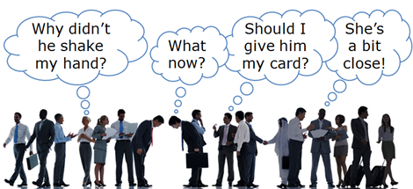
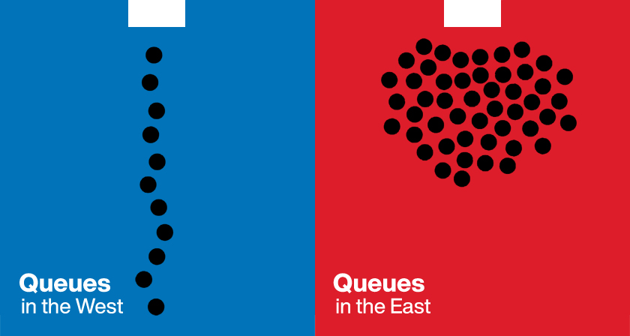
Cultural Values/Perception Spectrums (Examples):
Time and Event
Individual and Collectivism
Low and High Power Distance
Direct and Indirect Communication
Fatalism and Existentialism
Notes:
For our first exercise we will be going over some
-> Cultural Values and Perception spectrums. I’ll define the spectrums first then, with your partner discus where your culture wants you on these spectrums.
->the first spectrum is Time Event. A good example of this is, if your going to a party, does it start at the appointed time, or when everyone gets there.
->For individual and collectivism, how much is your identity found in yourself, in your family, and in your communities.
->Low and High power distance is like under what circumstances would you get coffee with your boss
-> Direct and Indirect communication is often best seen when a mistake is made, how much do you blatantly point out the mistake, and how much tactfulness is needed to address the mistake.
-> Fatalism and Existentialism is how to what extent do you believe that your life is predetermined, and how much control do you have over your own destiny.
There is alot to talk about, but we don’t have much time, so take about 5 min to discuss with your partner about whatever stuck out.
(5 min exercise)
Alright times up, I hope everyone was able to express how there own culture expects people to think/behave on some of these issues. Now I’ve got one more exercise for you.

Slide 7
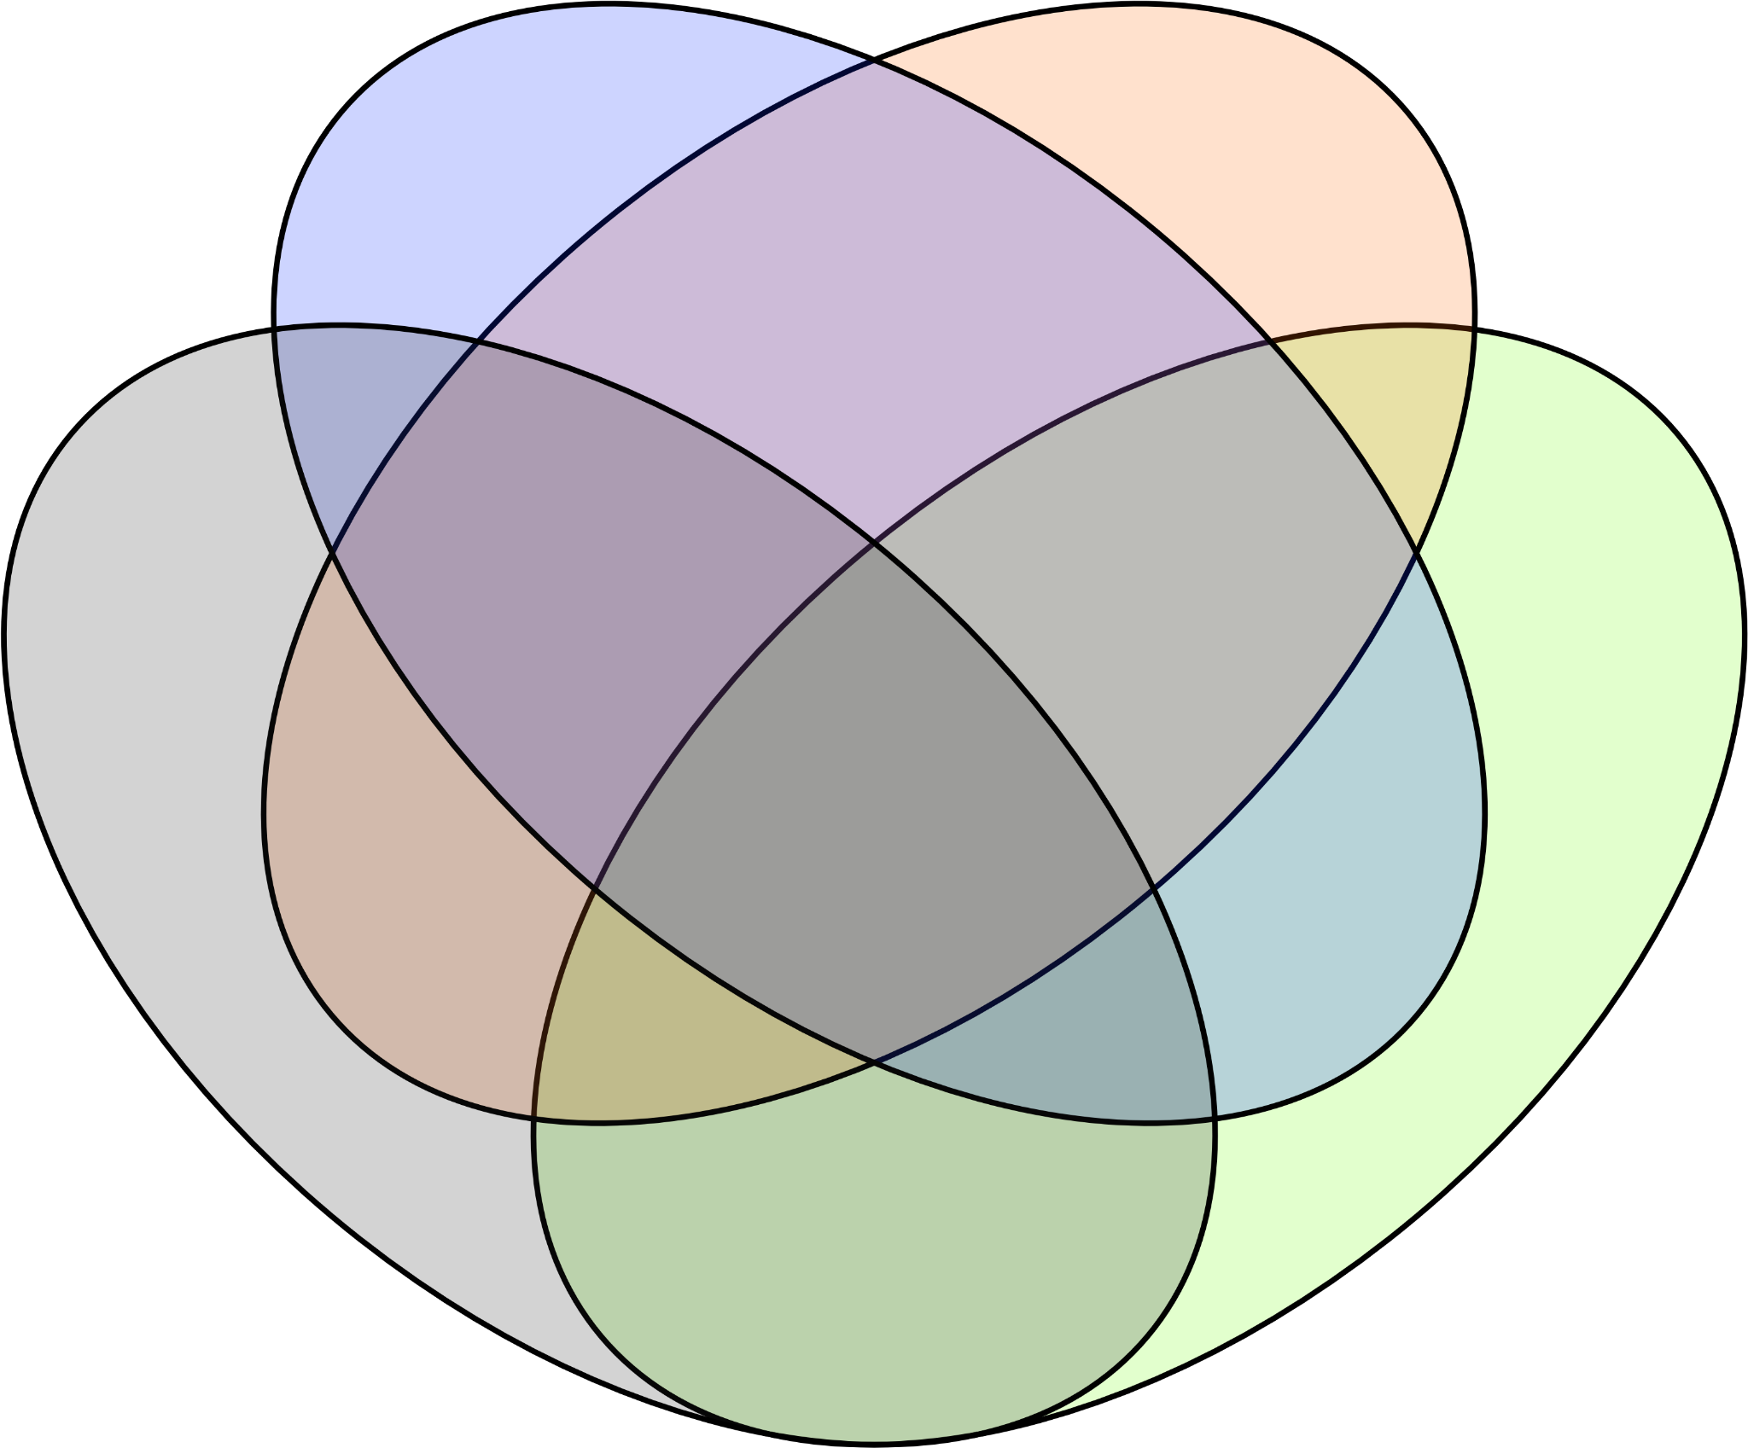
Cultural Influences
(Examples):
Family
Peers
Etc.
Organizations
Notes:
Here we see many different groups that influence our cultural upbringing. These are just examples, and by no means exhaustive.
For this exercise, I want people to start to think about how each one of these groups have impacted your values, for example your family may have scoffed at people who wore tight clothing, reinforcing a dislike of skinny jeans. For a little more clarity, Organizations are things like your church or job, or other institutions that have made an impact on you culturally, and if there is some other group that has made an influence in your life, just put it into the Etc. for now.

Slide 8
Goals
Develop awareness of our own culture and its impact on us
Learn to appreciate & evaluate different perspectives.

Slide 9
Cultural Self Awareness
Humility
Diverse Cultural Appreciation

Slide 10
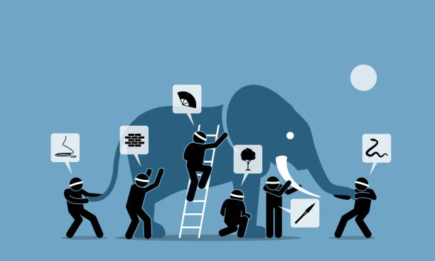
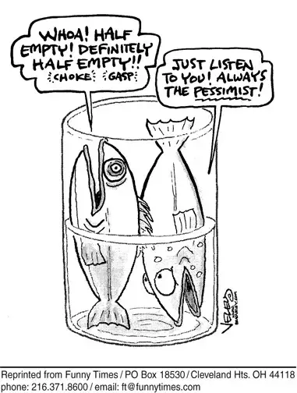
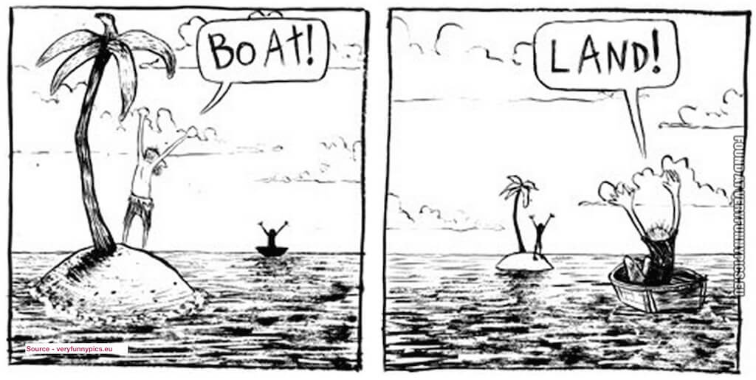
Different Perspectives

Slide 11
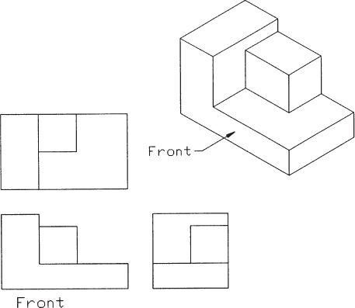

Slide 12

Quick Judgement:
How fast do we make judgments about other people?
More than 5 min
1-5 min
30-60 sec
10-30 sec
Less than 10 sec
2.4-4.6 sec

Slide 13



Slide 14
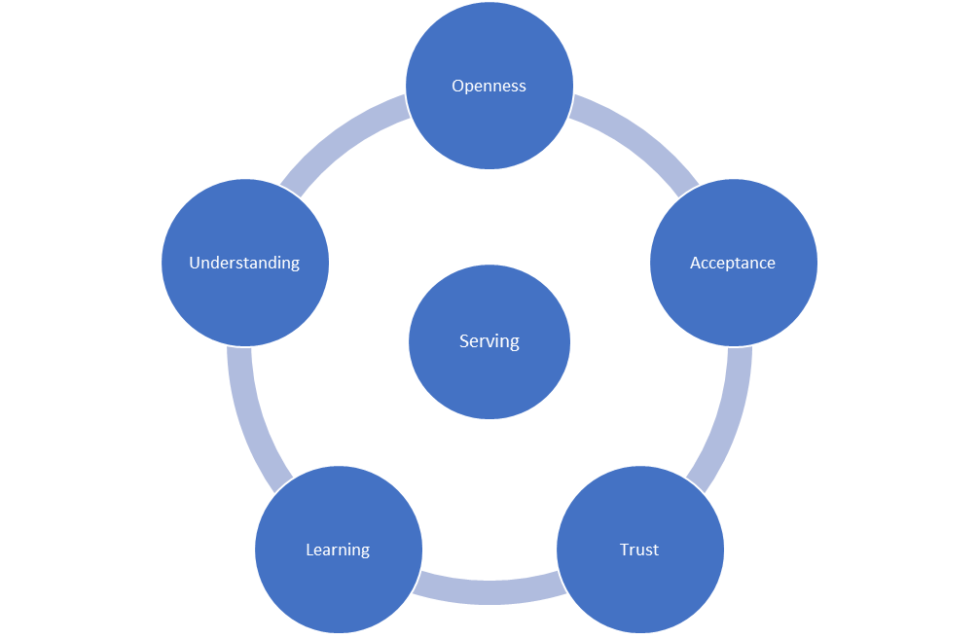
Skills to practice:
Be quick to listen and slow to speak
Recognize when you are making a quick judgement
Stop & ask if there is enough evidence to form a judgement

Slide 15
FIN

